Slide 1
It Takes a Village to Raise Send a Child to College by Elyse Danckers & JP Paulus
2015 Conference

Slide 2
intro
We’ve heard it so much it feels like a cliché…
Yet it’s True!
But for us in college access, what exactly IS this village, and how can we work together help our youth go to – and graduate – college?

Slide 3
Why
Parents / Family
Student’s adult network
(the village)
Teachers
School Counselors
Coaches
Friends
After School Programs
Church / religious leaders
Notes:
Be a Pain. This individual can help you stay on the right track to college, he or she will:
Provide encouragement.
Help you explore career interests.
Help you meet your academic requirements.
Guide you to college resources.
Help you with the financial aid process and college applications.

Slide 4
Who are we to talk about this village?
Elyse Danckers
Peter Kim
JP Paulus

Slide 5
Waukegan to College creates brighter futures for students, families and communities by preparing students to enroll in and graduate from college
2014 Excellent Emerging Organization Award Winner

Slide 6
The Need in Waukegan
Its population, close to 90,000, is 53 percent Latino, with a median income of $46,885 (2009). Only 16.6% of residents hold a Bachelor’s Degree or higher (US Census Bureau)
Waukegan High School has 4,000 students served by two part-time college counselors. Guidance counselors have a caseload of up to 400 students.
The majority of Waukegan High School students are not prepared for college – 18% college ready (Illinoisreportcard.com).
There are few if any programs to orient parents to the college process.

Slide 7
Quick Facts
Founded in 2009 by Lake County United
need identified at community listening sessions
based on 9 months of research and design
initially funded by Episcopal Charities
In 2012, W2C became an independent 501c3 organization

Slide 8
Quick Facts
In 6 years, W2C has sent every graduating high school senior to college. Younger students are on the honor roll, many for the first time.
Growth from 25 students (2009) to 80 students (2014)
4 staff (3 are part time), 100+ volunteers

Slide 9
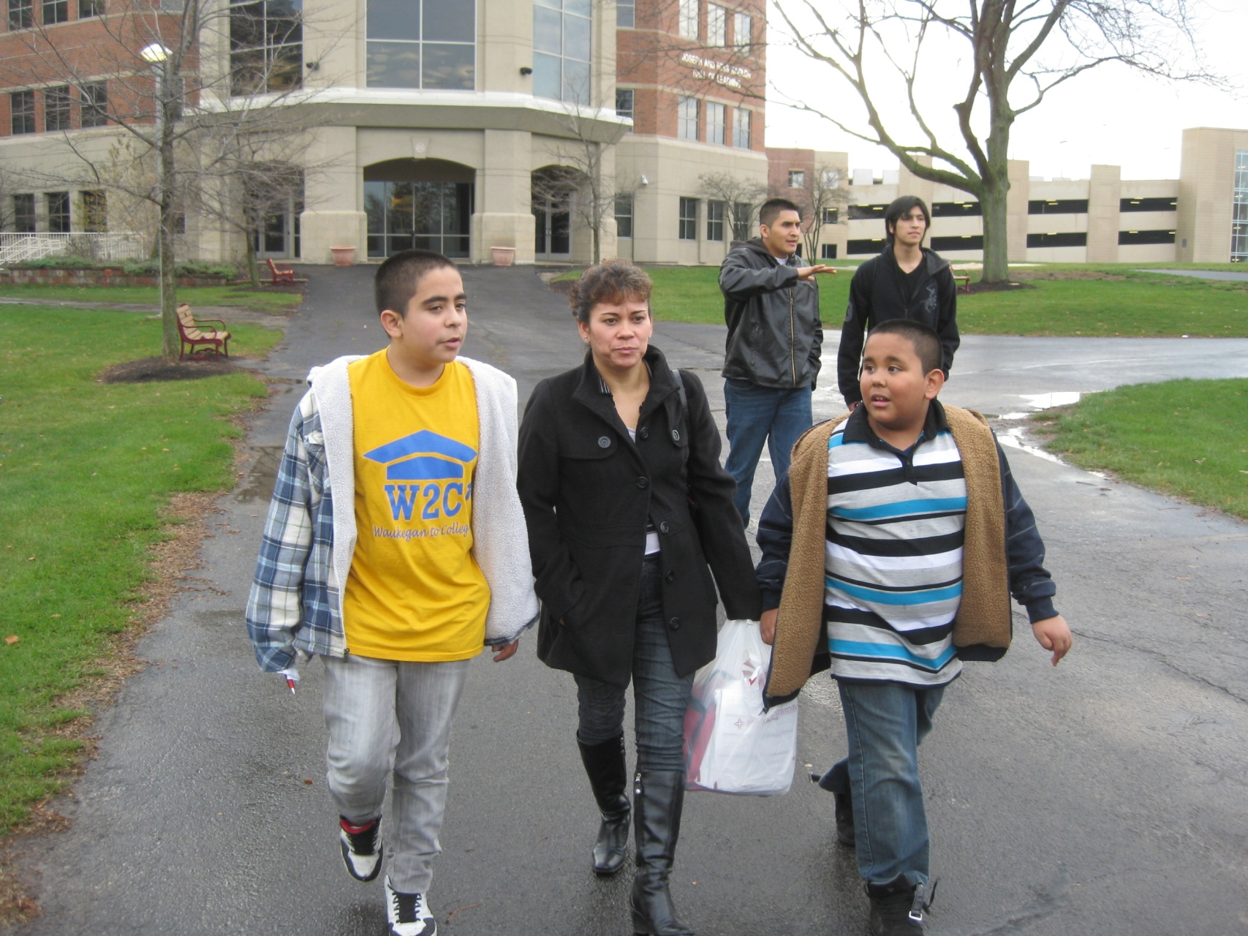
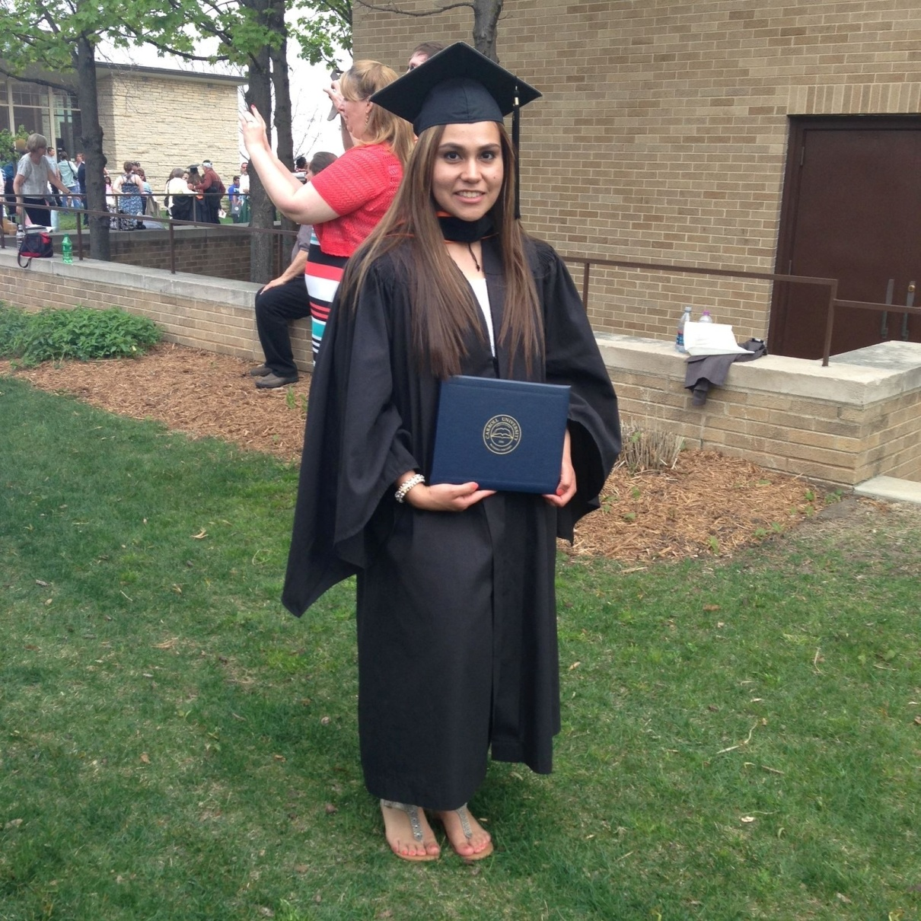
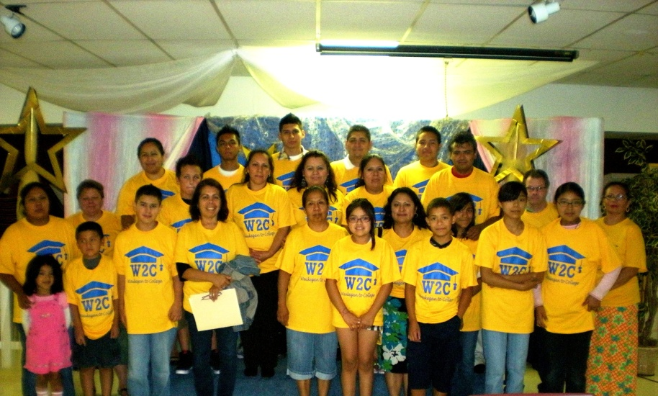
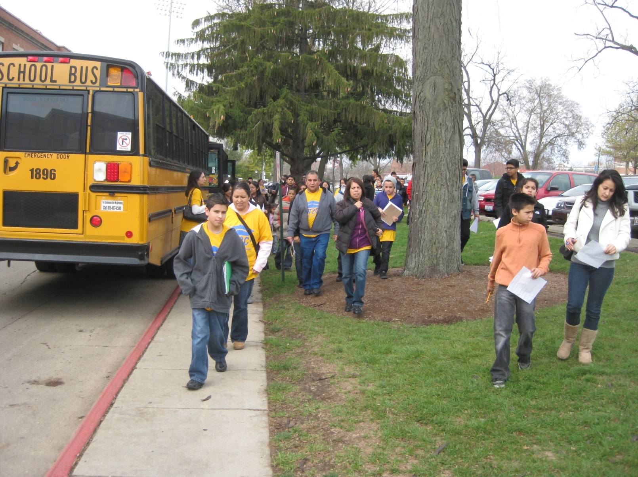
Who We Serve
Students :
-5th grade and up
-First-generation-college-going
Low income families
Majority Latino

Slide 10
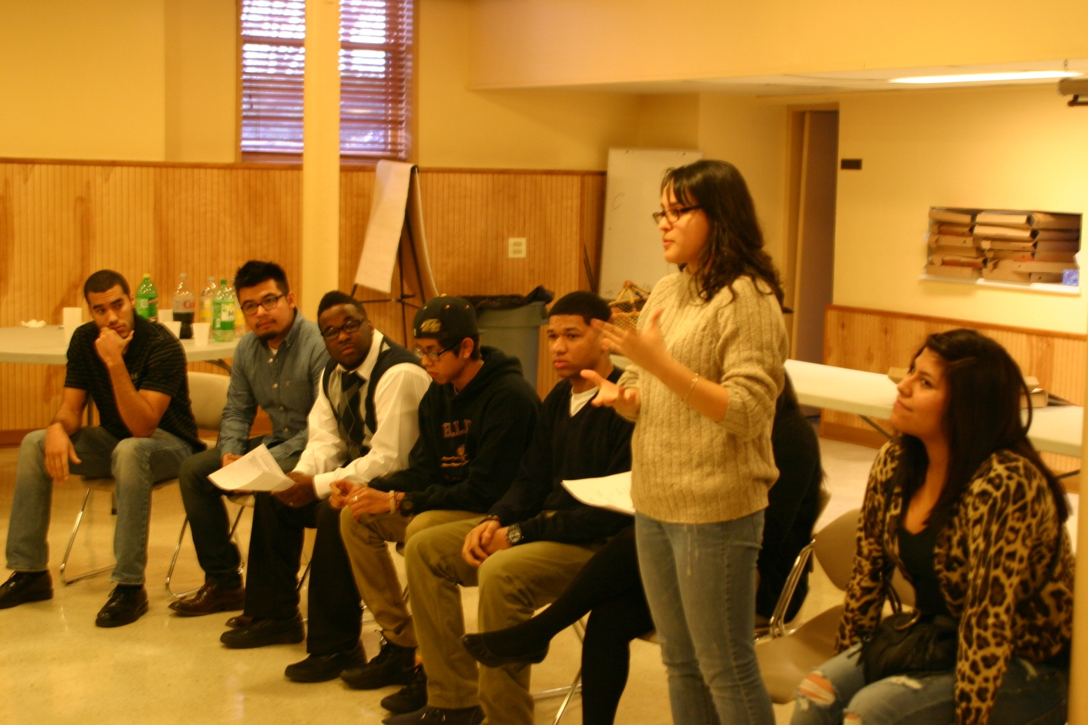
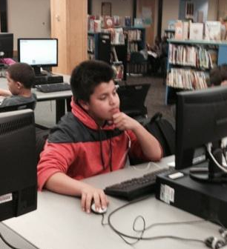
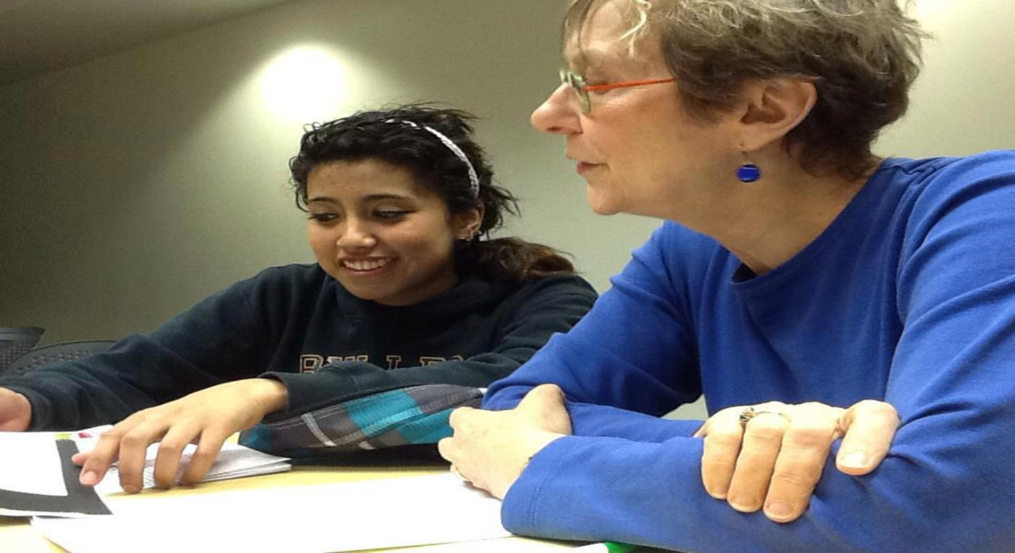
What We Do
One-on-One Counseling With Families
Family Workshops
Community Service
Academic Enrichment:
Read to Achieve
Tutoring
Khan Academy
Mentoring
Expanding Horizons

Slide 11
Counseling with a small “c”
Look at all of your child’s homework everyday – don’t just ask if they had any homework.
If your child really doesn’t have homework, make sure that your child reads, studies vocabulary words or reviews math material.
Keep track of your child’s academic progress and check all grades and test results. – Infinite Campus training
Make an appointment with your child’s teacher to review and understand the results.

Slide 12
Counseling with a small “c”
Ask the teacher how to best help your student in the areas of need.
Students want to watch TV or play video games before doing homework. Encourage your student to finish their homework then engage in active play.
Investigate where and when student tutoring is available and get help for your student if he/she needs it.
Make sure your student has a quiet place to do homework and study.

Slide 13
Counseling with a small “c”
TV and Video Games should continuously limited during the school week. This includes TV time for parents!
Education isn’t only at school – look for other opportunities (e.g., local library)
Be an example for your student. Let your student see that you also read and are learning something new.
It is most important that your student not miss school . Make appointments before or after school; do not miss any school because of vacations!

Slide 14
Program Recruitment
Parent and Student applications
Parent and Student interviews – current W2C parents interview prospective parents
New families assigned to a Parent Leader

Slide 15
Program Recruitment
Expectations –
attend monthly counseling,
attend monthly workshops,
arrange transportation for children to attend tutoring,
Participate in fundraisers and community service

Slide 16
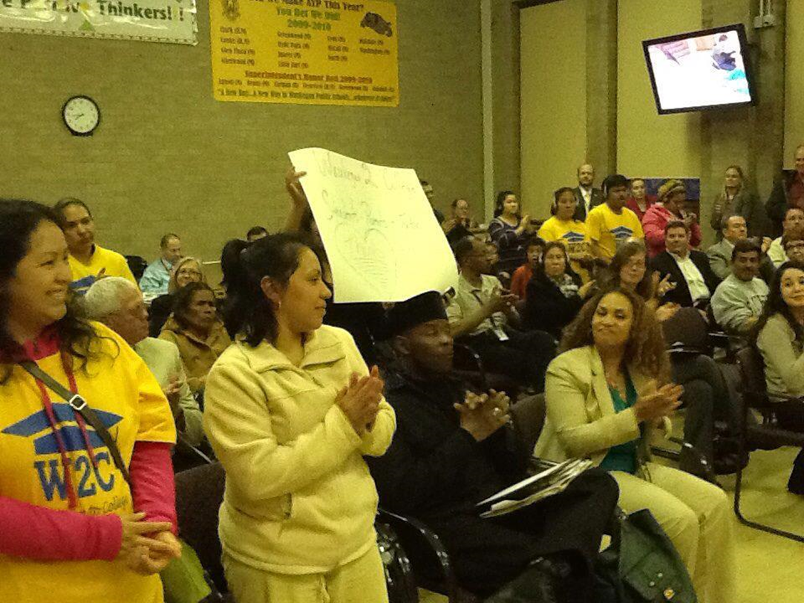
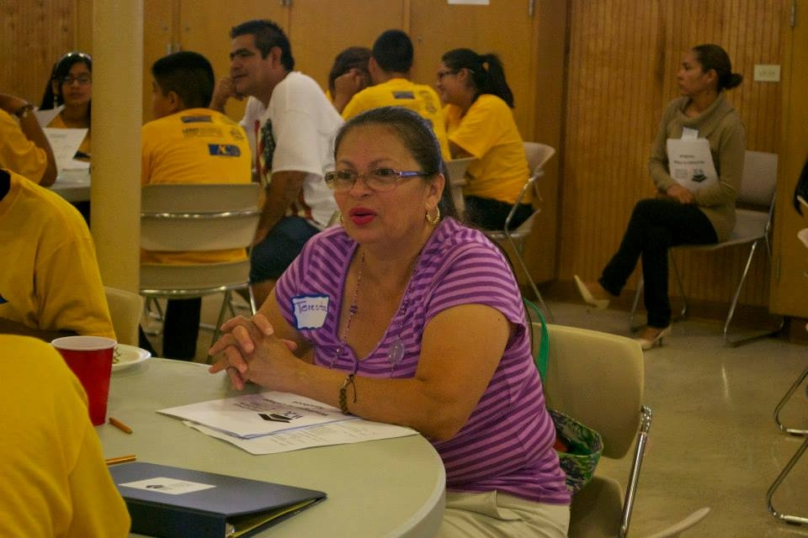
W2C Parent Leaders
Team of 11 W2C parents
5 W2C Board of Directors members
W2C parent ran for D60 School Board
Formalized structure -
Officers
Committees: Parent Engagement, Community Organizing, Fundraising, Community Service
Each Leader shepherds 3-5 families

Slide 17
Engaged Parents Produce Results
Every year, all W2C high school graduates have gone to college
College graduates: Evelin Serrano, Gilberto Colin, Luis Tinoco
10 seniors in 2014-15 will be attending Augsburg College, College of Lake County, Denison University, DePauw University, Dominican University, Georgetown University, Pomona College, and University of Illinois Springfield

Slide 18
Engaged Parents Produce Results
More than 80% of W2C students either maintained As or Bs in English or improved their grades; 60% of W2C students either maintained As or Bs in math or improved their grades
Nearly all students (96%) participated in a summer enrichment activity

Slide 19
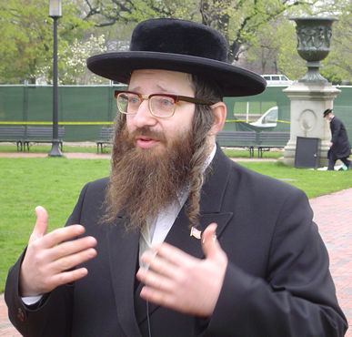
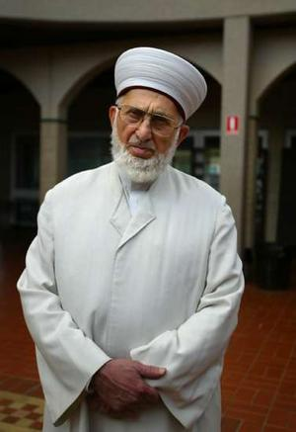
Reaching out to Religious Groups

Slide 20
Why
Major influence on people
In people’s lives weekly, if not daily
Have resources
Have local connections
Homeschoolers & private school kids
May know politicians & business leaders
Building space
Presentation technology
Trusted source of information
People who can influence our youth
Communication networks
Often connected to multiple family members and friends
Local businesses, restaurants, donors, volunteers

Slide 21
Why
Have extended networks
Denominations
Have stable/ want-to-be stable families
They trust their religious leaders
Have lifelong connections with youth
Often know youth (and families) since birth, follow them through high school and even college
They have a strong presence in the community
79th & King = 80 Churches in 1 square mile
3000 in the city of Chicago
Churches can reinforce societal messages
Ministry partners, volunteers, mission groups

Slide 22
How
Have EXTENSIVE address book/calendar
Add “best way to communicate “ category
Understand their calendar
May/June bad for schools; what about your institution? (denominational conference, youth retreats, etc.)
Cell phone, office phone, e-mail, text, Facebook, Twitter, tackle them at their office, etc.

Slide 23
How
Give specific action points & boundaries
Give a schedule of activity
Plan a specific event
FAFSA completion, 1st Sunday in January (*exceptions)
What to do during freshman year, etc.
Set boundaries of what is discussed
After service event vs. general public

Slide 24
How
Be Real
Don't fake "getting" them if you don't share the beliefs
Asian example: Japanese & Indonesians
“Technobabble”
Might need someone to help network or “translate” (see future point)
Notes:
Technobabble – Star Trek. Example

Slide 25
How
Be Patient
newspaper subscription analogy
3000 churches in Chicago (75% theory)

Slide 26
How
People – not projects
Religious people fall into this trap as well, but they notice when it affects them
Make the main thing people – NOT a particular event or statistic

Slide 27
How
Leverage Networks
Neighborhood groups
Denominations
Colleges
North Park, Moody Bible Institute
Survey your members
example: schools asking families to list organizations they are involved in
megachurch example
Find "hub” personalities
Who gets mentioned a lot?
Some hubs may not be liked by some
Play the Kevin Bacon game

Slide 28
Obstacles
Prideful/ domineering leaders
Wrong leader
Pastor
- might be the one to approve a church's involvement, but not the one to follow up
Alternates: Administrative assistant, Youth Pastor/Director/Leader, lay leader
People who have their own agenda and/or want control your event
May need to find alternate (such as a smaller church, or different leader within the church)
May need to skip this source
Busy-ness
religious people juggle many hats
may have sincere desire to help in this area
- They care about you – but other people as well
- Paper stack example
Need extra follow-up… don’t mistake intent with ability to deliver
Investigate who the best point person is for outside connections

Slide 29
Obstacles
Dealing with seemingly conflicting goals
Evangelism of their good news is the priority
Respecting religious beliefs
Examples of sensitive issues
Range of conservatism
Example: Christian scale
Dealing with alternate priorities
Overcoming past hurts/prejudices
Shane Windmeyer of Campus Pride & Dan Cathy of Chick-Fil-A

Slide 30
Obstacles
Dealing with seemingly conflicting goals
often - goals: evangelize and/or “how do I keep my people on the right path?”
Find common goals
May need a trusted mediator/”translator”
“Are you taking me off my mission?”
Allow them room to exercise their main passion

Slide 31
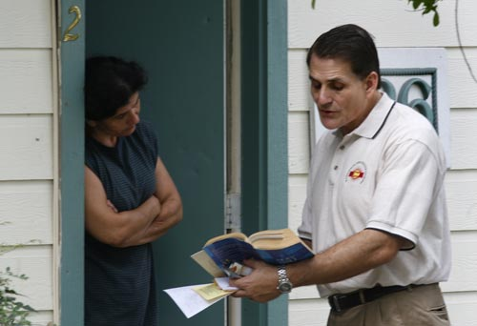
Obstacles
Dealing with seemingly conflicting goals
What agenda do you want me to push?
How much money do you want me to give up?
I’ve got the cure for cancer…

Slide 32
Difficulties
respecting religious beliefs
Some things you are offering are NOT in agreement with that religion’s beliefs
Need a “translator” or “bridge” to help you point out important items that are relevant to the religious organization’s context
Example: some orthodox Jewish and Muslim believers do not believe in loans

Slide 33
Obstacles
range of conservatism
Different types require different responses
Value different people

Slide 34
Scale of Theological Conservatism (Christian)
Obstacles
This is an approximate map of theological standings (South side vs. 1600 block of E. 51st ) . This is NOT a judgment on theology.
Play the Kevin Bacon game
Not an exact measurement, but will help to know approximately where they stand. (examples: Salem Baptist is different from Trinity United)
Extreme views (such as Westboro Baptist) are NOT a part of this range
Individual aspects (such as style of worship, stance on a particular issue, dress code) may vary with a church, but this is a general stance

Slide 35
Scale of Theological Conservatism (Christian)
Obstacles
Unitarian – Universalist
Trinity United Church of Christ, American Episcopal Church
Liberty University, 1st Baptist of Hammond, Pentecostal
Fundementalist
Moody Bible Institute, Salem Baptist, Southern Baptist, New Life Covenant Charismatics
Wheaton College, Willow Creek, LCMS, Nazarene
Roman Catholic (mid-level leadership), American Baptists, AME
Emergent Village
Red Letter
St. Sabinas
North Park University, Evangelical Covenant, New Life Covenant SE,
United Methodist, Lutheran (ECLA) or Presbyterian church
OFF the scale – Westboro Baptist

Slide 36
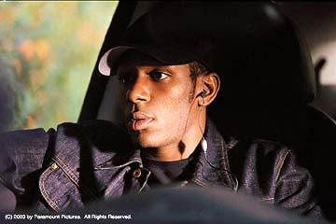
Difficulties
overcoming past hurts & prejudices
I had. A bad. Experience.

Slide 37
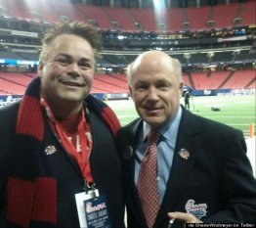
Difficulties
overcoming past hurts/prejudices
Shane Windmeyer of Campus Pride & Dan Cathy of Chick-Fil-A

Slide 38
Questions? Thoughts? Concerns? Ideas?

Slide 39
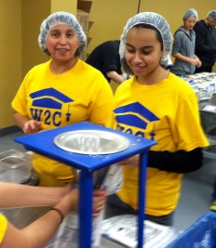
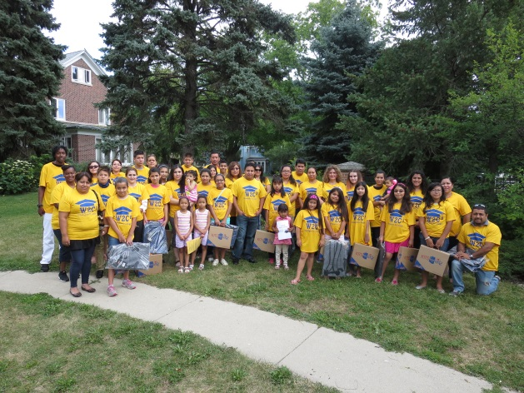
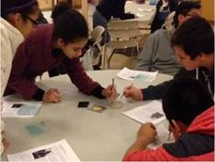
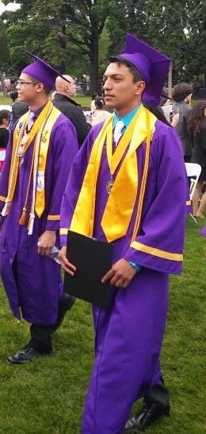
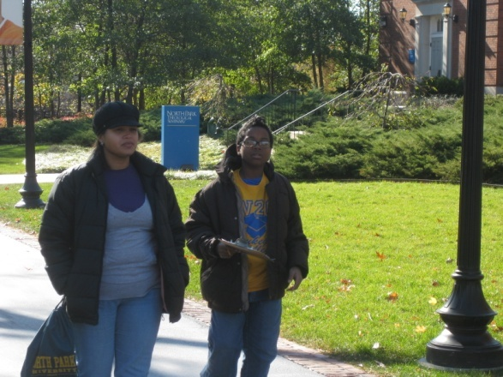
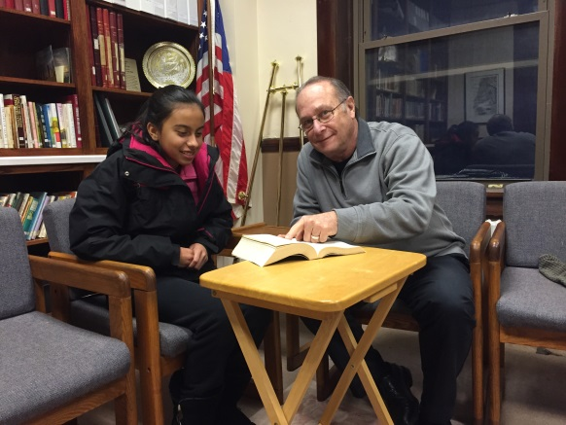
For more information, contact:
Elyse Danckers
Executive Director
Edanckers.w2c@gmail.com
www.waukegantocollege.org
Elyse Danckers Waukegan 2 College
Waukegan IL

Slide 40
Contact us JP Paulus @ Do-Gooder Consulting
P.O.Box 199233 Chicago IL 60619-9233
872-222-8008 info@do-gooder.us
Blog.do-gooder.us
www.do-gooder.us
Facebook/Twitter: @DoGooderChicago
HELPING YOU HELP OTHERS…

Slide 41
Peter Kim
Peoria Christian School
3506 N. California Ave. Peoria, IL 61603
T 309.686.4500
F 309.686.2569
pkim@peoriachristian.org
Dream Center Peoria 714 Hamilton Blvd. Peoria, Illinois 61603 t: 309.676.3000 f: 309.676.7986 dcpinfo@dreamcenterpeoria.org
www.dreamcenterpeoria.org

Slide 42
Difficulties

Slide 43
Assessment
It’s worth the effort!
You need the right people (from your end as well as those you want to reach out to).
It won’t always work out, but that’s OK. Just try again with different people at a later time.
Be prepared to do the follow-up. Trust their intent – but respectfully (and internally) doubt their schedule.
This is all about the CHILDREN!
Questions??? Thoughts?

